Slide 1


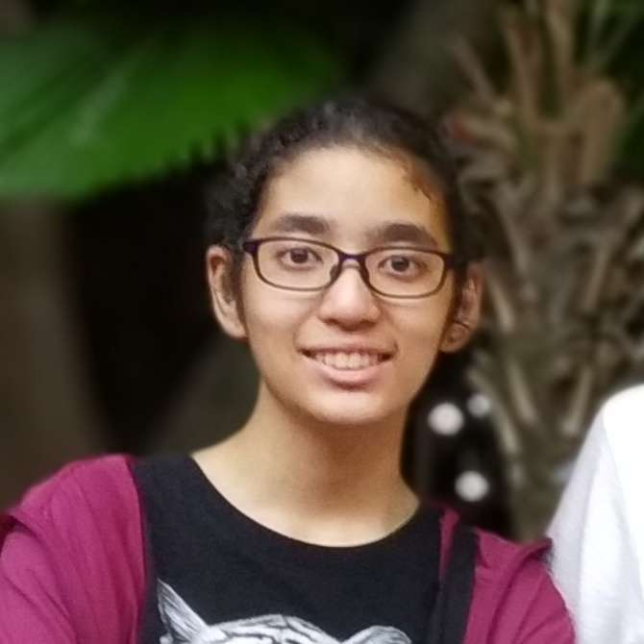

TOMOWORK GOAL SETTING WORKSHEET
NAME
Tanya Anastasha
INSTITUTE
Singapore Polytechnic
GOAL START DATE
20 MARCH 2023
GOAL COMPLETION DATE
1 JUNE 2023
MY CAREER GOAL IN _2__ YEARS
WORK
Work in digital media industry as digital illustrator, concept artist or animator
LEARNING
Relearn animation, and learn UI/UX Design
ACTIVITIES
Participate in art conventions, selling art prints or merchs
5 THINGS I WANT TO ACHIEVE FROM TAP (Please include more than 1 soft skills)
ACTION THAT WILL HELP ME TO REACH MY GOAL
REVIEW
(REVIEW BY 31 MAY MORNING)
1 | Expand my CV and Resume
2 | Learn Data Analytic and UIUX Design
3 | Develop new skills beyond diploma
4 | Improve my interpersonal skills
5 | Increase confidence in presentation
1 | Attend the sessions as much as I can
2 | Complete two tracks in e learning
3 | Work on projects with teammates
4 | Obtain skill certification
5 | Consistently expand my portfolio
1
2
3
4
5
COMMENTS FROM FACILITATORS

